Slide 1
POINTERS
Weeks 2 and 3

Slide 2
Addresses and Pointers
Address:
A uniquely defined memory location which is assigned to a variable.
Example - a positive integer value
<An analogy with post box>
Post office box number individual name contents
78 Johan Ridzwan catalog
Memory Address identifier contents
66572 x 105

Slide 3
Notation for memory snapshot
Memory Address identifier contents
66572 x 105
memory
address
66572
contents
105
x
identifier

Slide 4
Getting the Address of a Variable
Each variable in program is stored at a unique address
Use address operator & to get address of a variable:
int num = -99;
cout << &num; // prints address
// in hexadecimal

Slide 5
Example 1
#include <iostream>
using namespace std;
int main()
{
int x=25;
cout<<"The address of x is= "<<&x<<endl;
cout<<"The value in x is "<< x<<endl;
}

Slide 6
Results of Example 1
x
25
The address of x is 0x8f05
The value in x is 25;

Slide 7
Exercise Weeks 2/_1
Type & execute the following program
Check with your friend the address displayed.
#include <iostream>
using namespace std;
int main()
{
int x=25;
cout<<"The address of x is= "<<&x<<endl;
cout<<"The value in x is "<< x<<endl;
}

Slide 8
Pointer Variables
Pointer variable : Often just called a pointer, it's a variable that holds an address
Because a pointer variable holds the address of another piece of data, it "points" to the data
Pointer variables are yet another way using a memory address to work with a piece of data.
This means you are responsible for finding the address you want to store in the pointer and correctly using it.

Slide 9
Pointer Variables (cont.)
Definition:
int *intptr;
Read as:
“intptr can hold the address of an int”
Spacing in definition does not matter:
int * intptr; // same as above
int* intptr; // same as above

Slide 10
Pointer Variables (cont.)
Assigning an address to a pointer variable:
int *intptr;
intptr = &num;
Memory layout:
num
intptr
25
0x4a00
address of num: 0x4a00

Slide 11
Pointer Variables (cont.)
int a, b, *ptr ;
ptr = &a;
int a, b, *ptr = &a ;
or
ptr
a
0
b
0

Slide 12
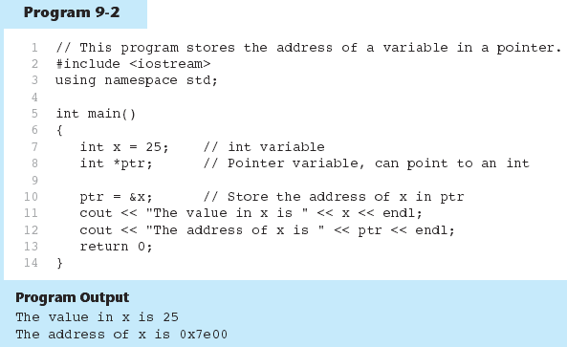
Pointer Variables - example

Slide 13
The Indirection Operator
The indirection operator (*) dereferences a pointer.
It allows you to access the item that the pointer points to.
int x = 25; int *intptr = &x; cout << *intptr << endl;
This prints 25.

Slide 14
Pointer Variables (cont.)
int a = 5, b = 9,
*ptr=&a;
b = *ptr;
ptr
a
5
b
9
ptr
a
5
b
5
b=*ptr : b is assigned the value pointed to by ptr

Slide 15
Pointer Variables (cont.)
ptr
int a = 5, b = 9, *ptr=&a;
*ptr = b;
a
5
b
9
ptr
a
9
b
9
*ptr = b : the value pointed to by ptr is assigned the value in b.

Slide 16
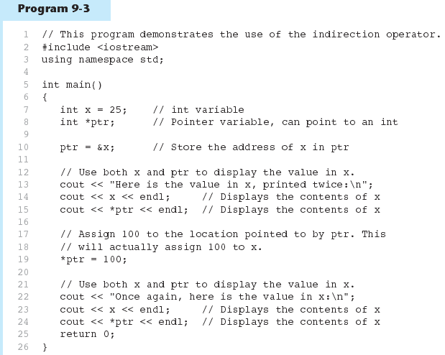
Pointer Variables - example

Slide 17
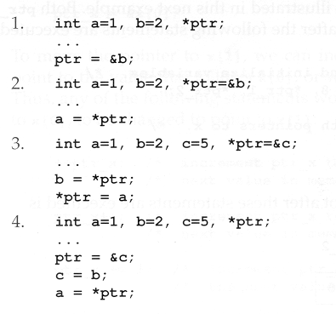
Exercise Weeks 2/3_2
Give memory snapshots after each of these sets of statements are executed.

Slide 18
Exercise Weeks 2/3_3
Refer to Exercise 2 No. 1 in pg. 59.
Refer to Exercise 2 No. 5 in pg. 61 & 62.
Solve the problems.

Slide 19
Something Like Pointers: Arrays
We have already worked with something similar to pointers, when we learned to pass arrays as arguments to functions.
For example, suppose we use this statement to pass the array numbers to the showValues function: showValues(numbers, SIZE);

Slide 20
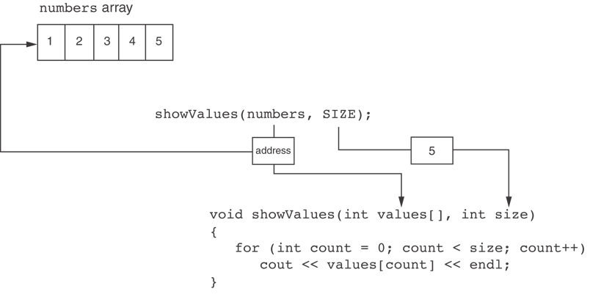
Something Like Pointers: Arrays
The values parameter, in the showValues function, points to the numbers array.
C++ automatically stores the address of numbers in the values parameter.

Slide 21
Something Like Pointers: Reference Variables
We have also worked with something like pointers when we learned to use reference variables. Suppose we have this function:
void getOrder(int &donuts)
{ cout << "How many doughnuts do you want? "; cin >> donuts; }
And we call it with this code: int jellyDonuts; getOrder(jellyDonuts);

Slide 22
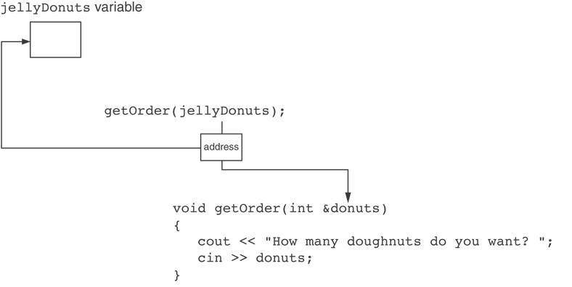
Something Like Pointers: Reference Variables
The donuts parameter, in the getOrder function, points to the jellyDonuts variable.
C++ automatically stores the address of jellyDonuts in the donuts parameter.

Slide 23

The Relationship bet. Arrays & Pointers
Array name is starting address of array
int vals[] = {4, 7, 11};
starting address of vals: 0x4a00
cout << vals; // displays 0x4a00
cout << vals[0]; // displays 4

Slide 24
The Relationship bet. Arrays & Pointers
int x[5], *ptr_x;
ptr_x = &x[0];
ptr_x
memory
allocation
?
?
?
?
?
x[0]
x[1]
x[2]
x[3]
x[4]
The memory location for x[1] is immediately
follow the memory location of x[0]

Slide 25
The Relationship bet. Arrays & Pointers
Array name can be used as a pointer constant:
int vals[] = {4, 7, 11};
cout << *vals; // displays 4
Pointer can be used as an array name:
int *valptr = vals;
cout << valptr[1]; // displays 7

Slide 26
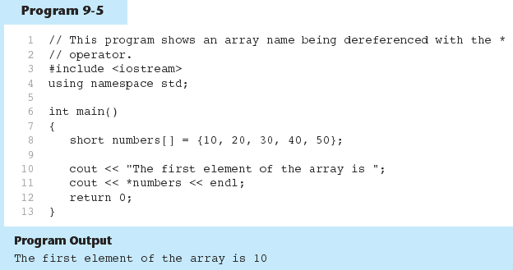
The Relationship bet. Arrays & Pointers (example)

Slide 27
Exercise Weeks 2/3_4
Refer to previous program in slide 26 Program 9-5.
Print the third element in the array using pointer number.

Slide 28
Pointer Arithmetic
Operations on pointer variables:
Operation | Example int vals[]={4,7,11}; int *valptr = vals;
++, -- | valptr++; // points at 7 valptr--; // now points at 4
+, - (pointer and int) | cout << *(valptr + 2); // 11
+=, -= (pointer and int) | valptr = vals; // points at 4 valptr += 2; // points at 11
- (pointer from pointer) | cout << valptr–val; // difference //(number of ints) between valptr // and val

Slide 29
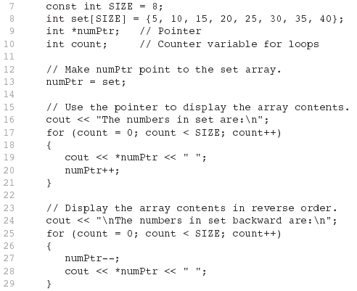
Pointer Arithmetic - Example

Slide 30
Pointers in Expressions
Given:
int vals[]={4,7,11}, *valptr;
valptr = vals;
What is valptr + 1? It means (address in valptr) + (1 * size of an int)
cout << *(valptr+1); //displays 7
cout << *(valptr+2); //displays 11
Must use ( ) as shown in the expressions

Slide 31
Pointers in Expressions
depends on the machine used
depends on the variable type
For examples,
Short integers ( 2 byte )
Floating point values ( 4 byte )
beginning : ptr = 45530
after ptr++ : ptr = 45532
beginning : ptr = 50200
after ptr++ : ptr = 50204

Slide 32
Exercise Weeks 2/3_5
Refer to Exercise 1 No. 6 and 7 in pg. 53.
Solve the problem.

Slide 33
Array Access
Array elements can be accessed in many ways:
Array access method | Example
array name and [] | vals[2] = 17;
pointer to array and [] | valptr[2] = 17;
array name and subscript arithmetic | *(vals + 2) = 17;
pointer to array and subscript arithmetic | *(valptr + 2) = 17;

Slide 34
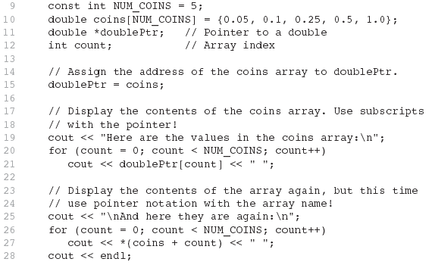
Array Access

Slide 35
Exercise Weeks 2/3_6
Refer to Exercise 2 No. 2 in pg. 60.
Solve the problem.

Slide 36
Initializing Pointers
Can initialize at definition time:
int num, *numptr = &num;
int val[3], *valptr = val;
Cannot mix data types:
double cost;
int *ptr = &cost; // won’t work
Can test for an invalid address for ptr with:
if (!ptr) ...

Slide 37
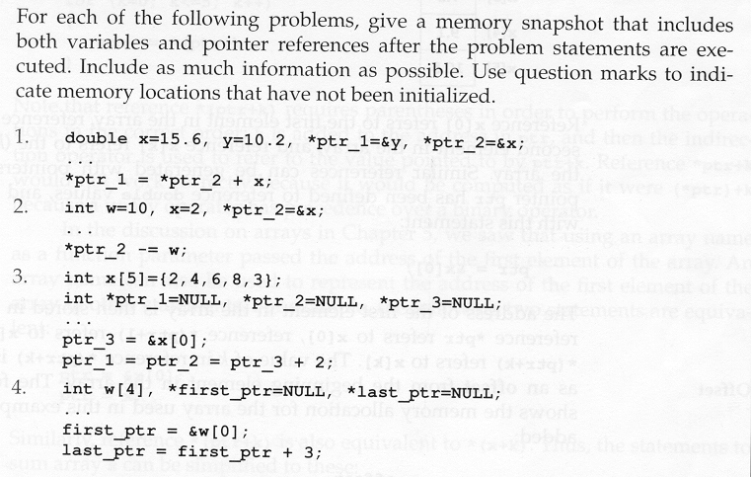
Exercise Weeks 2/3_7

Slide 38
Comparing Pointers
Relational operators (<, >=, etc.) can be used to compare addresses in pointers
Comparing addresses in pointers is not the same as comparing contents pointed at by pointers:
if (ptr1 == ptr2) // compares
// addresses
if (*ptr1 == *ptr2) // compares
// contents

Slide 39
Exercise Weeks 2/3_8
Refer to Exercise 1 No. 8 in pg. 54.
Solve the problem.

Slide 40
Pointers as Function Parameters
A pointer can be a parameter
implements call-by-address references
allows to modify the values by statements within a called function
Requires:
asterisk * on parameter in prototype and heading
void getNum(int *ptr); // ptr is pointer to int
asterisk * in body to dereference the pointer
cin >> *ptr;
address as argument to the function
getNum(&num); // pass address of num to getNum

Slide 41
Pointers as Function Parameters – Example 1
void swap(int *x, int *y)
{ int temp;
temp = *x;
*x = *y;
*y = temp;
}
int num1 = 2, num2 = -3;
swap(&num1, &num2);

Slide 42
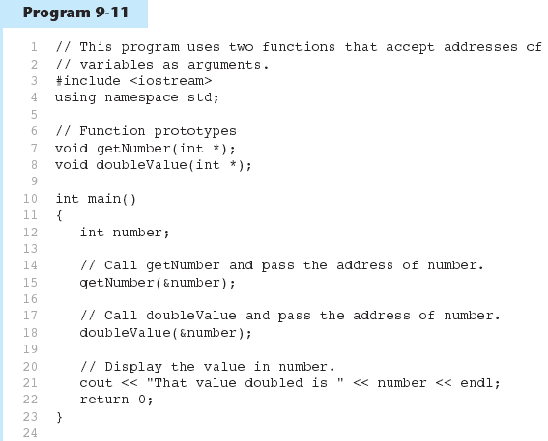
Pointers as Function Parameters – Example 2

Slide 43
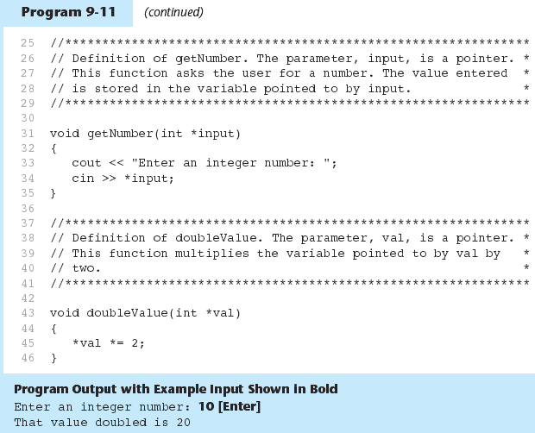
Pointers as Function Parameters – Example 2

Slide 44
Exercise Weeks 2/3_9
Refer to Exercise 1 No. 9 in pg. 54.
Refer to Exercise 3 No. 4 in pg. 68.
Solve the problem.

Slide 45
Pointers to Constants
If we want to store the address of a constant in a pointer, then we need to store it in a pointer-to-const.
Example: Suppose we have the following definitions: const int SIZE = 6; const double payRates[SIZE] = { 18.55, 17.45, 12.85, 14.97, 10.35, 18.89 };
In this code, payRates is an array of constant doubles.

Slide 46
Pointers to Constants
Suppose we wish to pass the payRates array to a function? Here's an example of how we can do it.
void displayPayRates(const double *rates, int size) { for (int count = 0; count < size; count++) { cout << "Pay rate for employee " << (count + 1) << " is $" << *(rates + count) << endl; } }
The parameter, rates, is a pointer to const double.

Slide 47
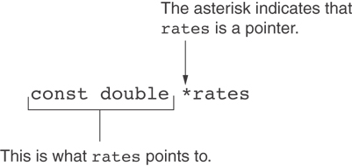
Declaration of a Pointer to Constant

Slide 48
Constant Pointers
A constant pointer is a pointer that is initialized with an address, and cannot point to anything else.
Example int value = 22; int * const ptr = &value;

Slide 49
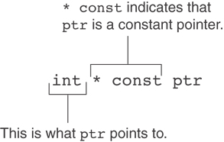
Declaration of a Constant Pointer

Slide 50
Constant Pointers to Constants
A constant pointer to a constant is:
a pointer that points to a constant
a pointer that cannot point to anything except what it is pointing to
Example: int value = 22; const int * const ptr = &value;

Slide 51
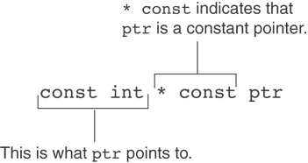
Constant Pointers to Constants

Slide 52
Exercise Weeks 2/3_10
Refer to Exercise 1 No. 10 and 11 in pg. 55 and pg. 56.
Solve the problem.

Slide 53
Dynamic Memory Allocation
Can allocate storage for a variable while program is running
Computer returns address of newly allocated variable
Uses new operator to allocate memory:
double *dptr;
dptr = new double;
new returns address of memory location

Slide 54
Dynamic Memory Allocation (cont.)
Can also use new to allocate array: const int SIZE = 25; arrayptr = new double[SIZE];
Can then use [] or pointer arithmetic to access array:
for(i = 0; i < SIZE; i++)
arrayptr[i] = i * i;
or
for(i = 0; i < SIZE; i++)
*(arrayptr + i) = i * i;
Program will terminate if not enough memory available to allocate

Slide 55
Releasing Dynamic Memory
Use delete to free dynamic memory:
delete fptr;
Use [] to free dynamic array:
delete [] arrayptr;
Only use delete with dynamic memory!

Slide 56
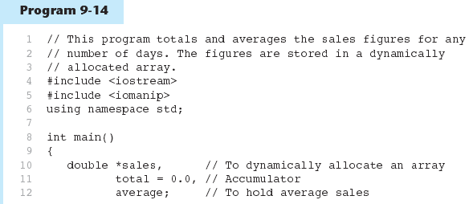
Dynamic Memory - example

Slide 57
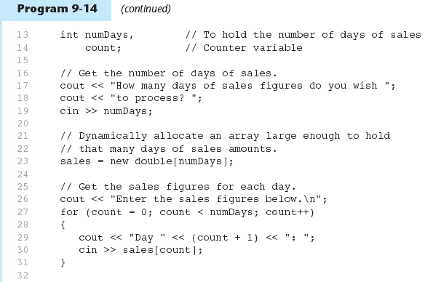
Dynamic Memory - example

Slide 58
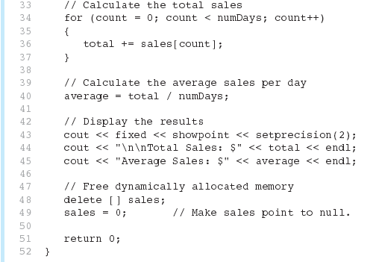
Dynamic Memory - example

Slide 59
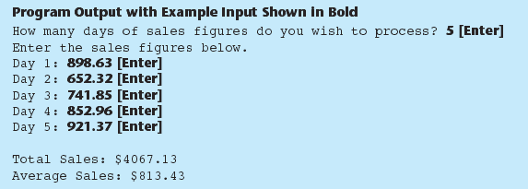
Dynamic Memory - example
Notice that in line 49 the value 0 is assigned to the sales pointer. It is a good practice to store 0 in a pointer variable after using delete on it. First, it prevents code from inadvertently using the pointer to access the area of memory that was freed. Second, it prevents errors from occurring if delete is accidentally called on the pointer again. The delete operator is designed to have no effect when used on a null pointer.

Slide 60
Exercise Weeks 2/3_11
Given the following program with 3 errors. Rewrite the program to store the power value of the array’s index and print the values.
int main(){
const int SIZE = 25;
int *arrayptr;
arrayptr = new double[SIZE];
for(int i = 0; i < SIZE; i++)
*arrayptr[i] = i * i;
for(int i = 0; i < SIZE; i++)
cout <<*arrayptr + i<<endl;
return 0;
}

Slide 61
Exercise Weeks 2/3_12
Refer to Exercise 2 No. 10 in pg. 65
Solve the problems.

Slide 62
Returning Pointers from Functions
Pointer can be the return type of a function:
int* newNum();
The function must not return a pointer to a local variable in the function.
A function should only return a pointer:
to data that was passed to the function as an argument, or
to dynamically allocated memory

Slide 63
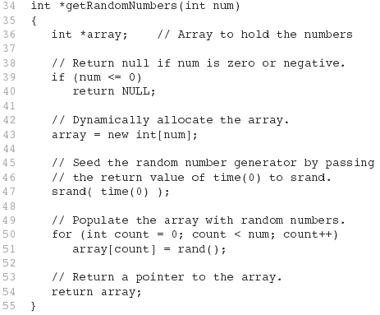
Returning Pointers from Functions - example

Slide 64
Exercise Weeks 2/3_12
Refer to Program5_12.cpp (Ex. 3, No. 2) in page 66.
Change the function using the following function prototype:
int* getStudentID(int studentNum);

Slide 65
Pointers to Structures
A structure variable has an address
Pointers to structures are variables that can hold the address of a structure:
Student *stuPtr;
Can use & operator to assign address:
stuPtr = & stu1;
Structure pointer can be a function parameter

Slide 66
Accessing Structure Members via Pointer Variables
Must use () to dereference pointer variable, not field within structure:
cout << (*stuPtr).studentID;
Can use structure pointer operator to eliminate () and use clearer notation:
cout << stuPtr->studentID;

Slide 67
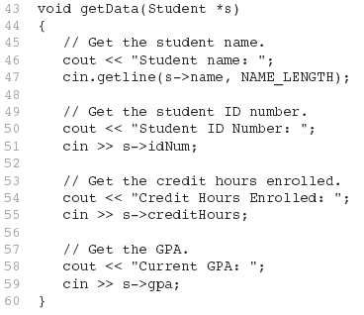
Pointers to Structures - Example

Slide 68
Exercise Weeks 2/3_13
Refer to the Additional Lab2 material.
Solve the problem.

